Slide 1
IMPLEMENTATION OF TCP on Intel DE2I-150 Board Networked System Design (EE-550)
By
Avinash Palamanda (50166647)
Aravind Srinivas S.P (50166473)
Darshan G Malleshappa (50170064)
Sandeep Shanmugarajan (50166471)

Slide 2
Introduction :
A transport-layer protocol provides for logical communication between application processes running on different hosts.
UDP - Connection Less
TCP - Connection Oriented.
TCP - Before one application process can begin to send data to another, the two processes must first “handshake” with each other.

Slide 3
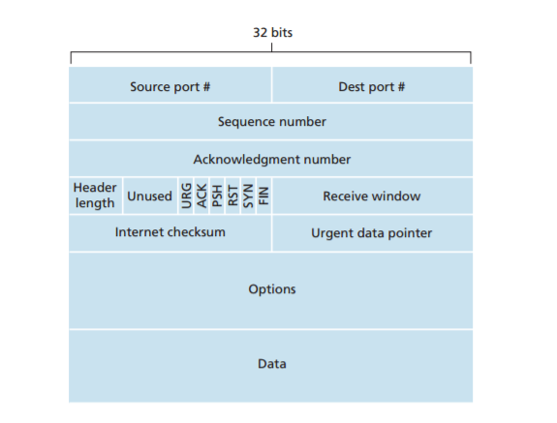
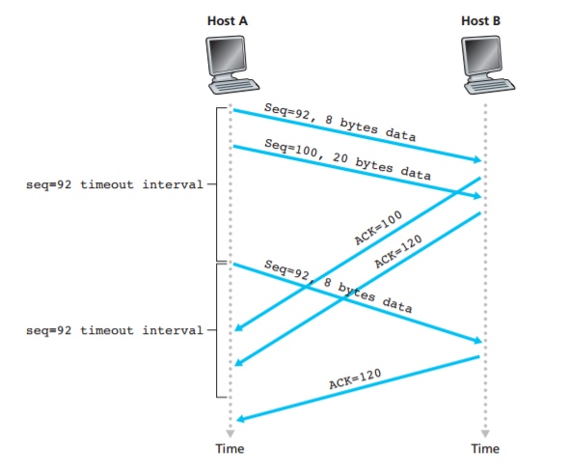
TCP
Frame Format
Window
Cumulative Acknowledgement
One Timer
Out of order reception
Has characteristics of both GBN and SR.

Slide 4
Simplified Implementation:
62
2
6
6
2
46
Preamble | Destination Address | Source Address | Length | Data
Destination Port | Source Port | Sequence Number | Ack Number | Flag Bits | Data
Data | Ack | Fin | Syn
2
2
2
2
1
35
TCP frame

Slide 5
Control Bits:
Data | Ack | Fin | Syn
Flag =0x01 Syn Bit is set
Flag =0x02 Fin Bit is set
Flag =0x05 Syn-Ack Bit is set
Flag =0x06 Fin-Ack Bit is set
Flag =0x08 Data bit is set
Flag=0x0C Data Ack bit is set
0 | 0 | 0 | 1
0 | 0 | 1 | 0
0 | 1 | 0 | 1
0 | 1 | 1 | 0
1 | 0 | 0 | 0
1 | 1 | 0 | 0

Slide 6
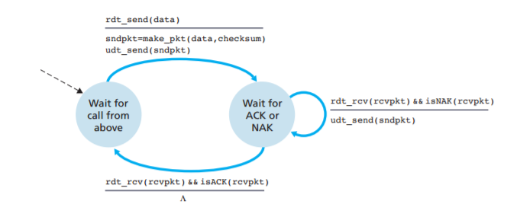
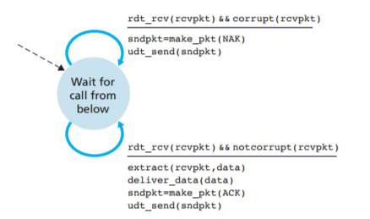
Stop and Wait:
NAK packet has not been implemented.
In case we receive wrong packet we drop them.
We know that the regular TCP uses selective repeat maintaining windows at both sender and the receiver. Since we faced certain clocking issues, to simplify the design we implemented the Stop and Wait protocol

Slide 7
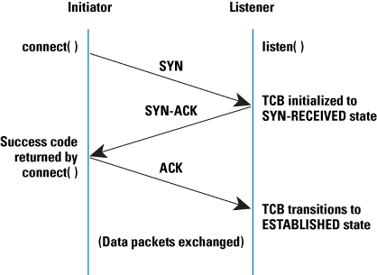
3 – Way Handshake
Link variable is defined in a struct to determine the connection status with the destination.

Slide 8
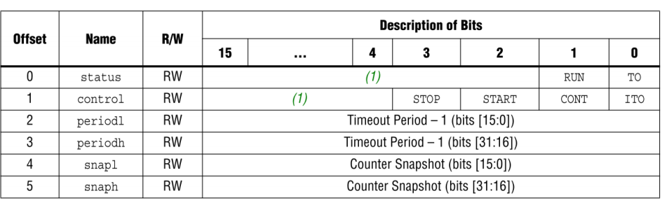
NIOS II Timer Module
The timer module we have used contains a 32 bit internal counter
Interrupt can be enabled/disabled upon the count reaching zero
A 32 bit counter/64 bit counter is present in the module while adding in Qsys, all of them use 16 bit registers though some of them may not be present

Slide 9
Functions definitions to READ/WRITE the timer
IOWR_ALTERA_AVALON_TIMER_STATUS(TIMER_0_BASE, 0x0000); //set TO bit – 0 if - 1
IOWR_ALTERA_AVALON_TIMER_PERIODL(TIMER_0_BASE ,0xAAAA); //timeout val
IOWR_ALTERA_AVALON_TIMER_PERIODH(TIMER_0_BASE , 0x00FF);//timeout val
IOWR_ALTERA_AVALON_TIMER_CONTROL(TIMER_0_BASE, 0x0007); //start timer
IOWR_ALTERA_AVALON_TIMER_CONTROL(TIMER_0_BASE, 0x0008); //stop timer
IORD_ALTERA_AVALON_TIMER_STATUS(TIMER_0_BASE); //Read Status of the timer
IORD_ALTERA_AVALON_TIMER_SNAPL(TIMER_0_BASE ); //Counter Snapshot
IORD_ALTERA_AVALON_TIMER_SNAPH(TIMER_0_BASE);//Counter Snapshot
Header files required
#include<altera_Avalon_timer.h>
#include<altera_Avalon_timer_regs.h>

Slide 10
Data Transmission and Application:
Here we have implemented a simple counter as an application.
We transmit the count value in each TX frame which increments upon successful transmission.
The other connected board, upon receiving the data, turns on the LED according to the data received.
To show the working of the timer and retransmission if there is link failure, we have set up SWITCH 3 to drop receiving frames.
We notice that there is no more incoming data on the RX side and retransmission happening at the TX side

Slide 11
Upon turning OFF the Switch 3, we notice data is received again starting from the next sequence number in the sequence number field of the TCP header.
Connection can be Established and Closed using Switch 1
SWICTH 1 | 3 Way Handshake
SWITCH 2 | Data Transmission
SWITCH 3 | Drop Receiving Frames

Slide 12
CONCLUSION
Implemented a simplified TCP on the intel DE2i-150 board using Verilog as the hardware programming language and C defining the software
Implemented the following:
3 way handshake for connection establishment and tear down
Stop and wait protocol
Timer to support stop and wait protocol for retransmissions of the frames of SYN/FIN/Data
Simple Counter as the application for which LEDs glow according to the sequence
Print the statistics of the Ethernet frames and TCP frames sent/received.

